Slide 1


INFO5990 Professional Practice in IT Lecture 10B
The Role of professional bodies
Codes of practice in the professions
The Australian Computer Society

Slide 2

Skipping slides today
Does not mean you don’t need to review them !

Slide 3
By the end of this lecture you will be able to:
Understand the role of professional bodies
Compare the code of ethics of two professional bodies
Appreciate the benefits of membership
Consider joining the Australian Computer Society (ACS)
Thought about professional responsibilities
Make decisions about whistleblowing

Slide 4
What is a profession?
An occupation, such as law, medicine, or engineering, that requires considerable training and specialized study.
Classically, there were only three so-called “learned professions”: divinity, medicine, and law
By 1900 pharmacy, veterinary medicine, nursing, teaching, librarianship, optometry and social work, all claimed to be professions

Slide 5
Milestones for emerging professions
What marks an occupation as a “profession”?
a full-time occupation;
training school established;
university school established;
local and national associations established;
code of professional ethics introduced;
state licensing laws established.

Slide 6
What is a Professional Body?
“a group of people in a learned occupation who are entrusted with maintaining control or oversight of the legitimate practice of the occupation” (www.qualityresearchinternational.com)

Slide 7
The Role of a Professional Body
To safeguard the public interest
To represent the interests of professional practitioners
Provide professional development programmes
To offer professional ‘certification’
To uphold its status as the relevant professional body in its domain
Accreditation of university courses

Slide 8

University Course Accreditation
Ensures that academic institutions meet national and international benchmarks
Evaluates degree programs against a designated criteria
Ensures that graduates meet professional requirements
Your courses have been accredited by the Australian Computer Society

Slide 9
What accreditation covers
The Teaching and Learning environment
Course structure and content
Quality assurance framework
Attention to ‘Soft Skills’
Hence the strong focus in INFO5990 on communication skills and team skills

Slide 10
Question 1
Which of the following is NOT seen as a role of a professional body
To safeguard the public interest
To represent the interests of professional practitioners
To protect members from being sued by the public
To provide professional development programmes
To offer professional ‘certification’

Slide 11
Acting ethically!
Code of ethics

Slide 12
Behaving Ethically
Ethical = “you would be happy to see details of your dealings on the front page of the Sydney Morning Herald”
But remember, ‘unethical’ does not necessarily mean ‘unlawful’ or ‘illegal’ …
… and conversely, ‘legal’ is not always the same as ‘ethical’.

Slide 13
Australian Computer Society Code of Ethics (7 Oct, 2009)
To uphold and advance the honour, dignity and effectiveness of the profession of information technology and in keeping with high standards of competence and ethical conduct, a member must:
(a) be honest, forthright and impartial
(b) loyally serve the community, and
(c) strive to increase the competence and prestige of the profession
(d) use special knowledge and skill for the advancement of human welfare.
http://www.acs.org.au/attachments/Code_of_Ethics.pdf

Slide 14

Comparison of Codes
Aust Computer Society
Engineers Australia
be honest, forthright and impartial
Demonstrate personal and professional integrity
loyally serve the community
Promote the wellbeing of individuals, communities and the environment
strive to increase the competence and prestige of the profession
Practice with professional competence
use special knowledge and skill for the advancement of human welfare.
Exercise responsible leadership.

Slide 15
Why have a code of ethics? (1)
Furnishes common, agree-upon standards for professional conduct. These are of benefit to both professionals and the public
Provides a focus for debate on how the code should be applied or perhaps modified

Slide 16
Why have a code of ethics? (2)
Provides rationale for a professional to adhere to professional standards even when pressured by others to violate them.
But, the code of ethics cannot cover every possible ethical situation. The professional may sometimes have to decide for him/her self.

Slide 17
In a nut shell
Members should place the interests of their client/employee and the community above their own personal/private interests
Members should act only in areas of their competence and in a careful and diligent manner
(Committee member of Engineering Australia)

Slide 18

Standard of conduct
A member is expected to act at all times in a manner likely to be judged by informed, respected, and experienced peers in possession of all of the facts as the most ethical way to act in the circumstances.
(Statement of the Australian Computer Society)

Slide 19
Code of Ethics: positives & negatives
Positive characteristics
Negative characteristics
Can help members make ethical choices.
Can alert members to ethical aspects they otherwise might overlook.
Can be used to discipline members when they violate the code.
Can inform the public about the role of the profession.
Are never complete or exhaustive.
May tend to be too general and too vague.
May be inconsistent
May not always be helpful in resolving conflict.
Are ineffective in disciplinary matters.
May be self-serving for the profession.

Slide 20
Q2 Which of the following statements about a code of ethics is FALSE?
A code of ethics furnishes common, agree-upon standards for professional conduct
A code of ethics provides a focus for debate on how the code should be applied
A code of ethics provides a rationale for a professional to adhere to in difficult situations
A code of ethics covers every possible ethical situation the professional is likely to meet
NONE of these is FALSE

Slide 21
Question 3
Which of the following is TRUE
The code of ethics of the ACS is quite different from the codes of all other professional bodies
The code of ethics of ACS is particularly strict
The code of ethics of ACS is rather vague
All members of ACS are expected to abide by the society’s code of ethics
Only certified members of ACS are expected to abide by the society’s code of ethics

Slide 22
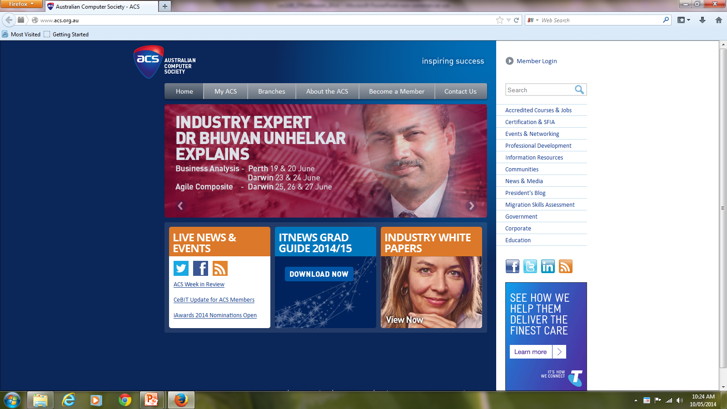
Australian Computer Society

Slide 23
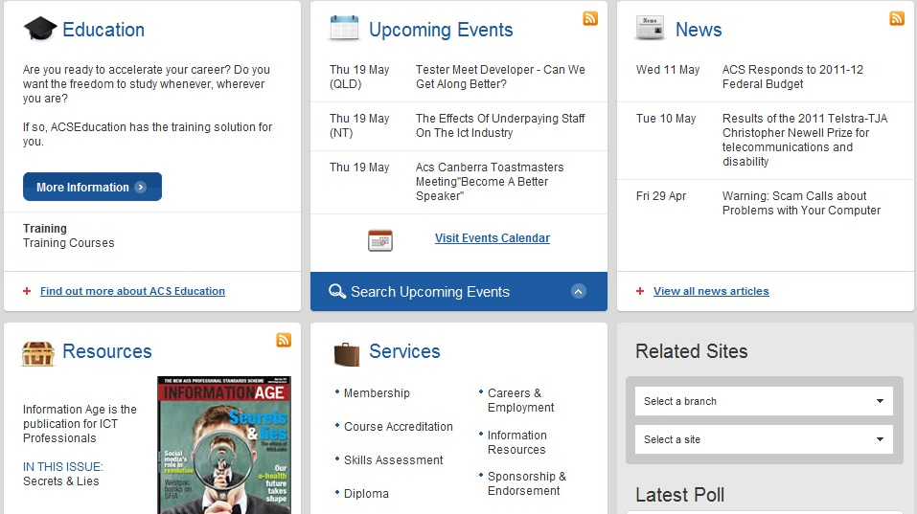
Australian Computer Society

Slide 24
Benefits of membership for you
Opportunities to “network” with other professionals in the area
Careers Service
job hunting, resumé writing, interviews
Publications and professional Library
Continuous professional development
seminars and information sessions
Achieving Certified status

Slide 25
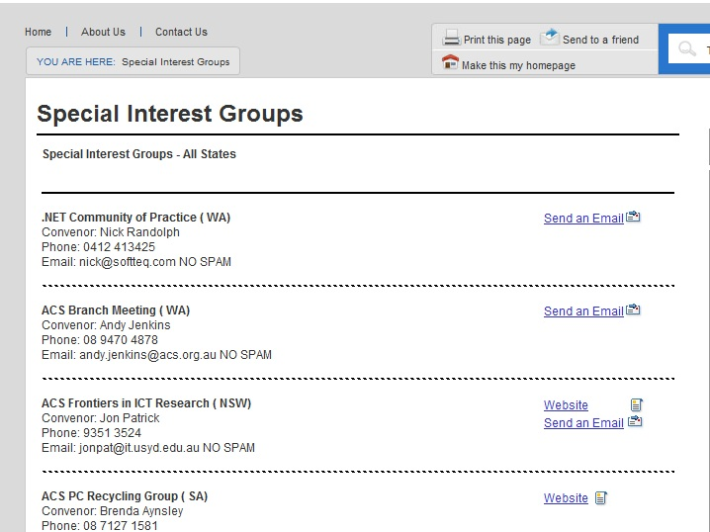
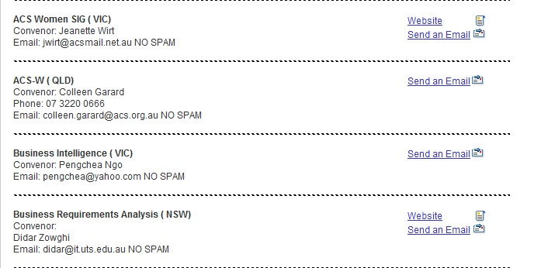
ACS: Special interest groups (SIG)

Slide 26

Australian Computer Society Journal
“Information Age” is the official bi-monthly publication of the ACS, supplied free to members.
The Australian Computer Society has won international recognition for, “Information Age” when it was launched

Slide 27
ACS Membership Fees
Student membership | $66 per year
Full Member | $352 per year

Slide 28
Australian Computer Society Certified Professional (CP) Benefits
Brings an added competitive edge and professional readiness
International Recognition Global acknowledgement of CP as the benchmark for professionalism
Strengthening of employment and marketability
Greater job mobility
There are currently no fees for members who apply for CP status.

Slide 29
What happens if an ACS member breaches the code of ethics?
Where a breach is proven, the ACS may choose to apply any of the following sanctions:
Admonition
Reprimand
Fine
Suspension
Expulsion
Specified professional development
Withdrawal of certification

Slide 30
Question 4
Which of the following is TRUE
Student membership in Australian Computer Society is free
Student membership in Australian Computer Society costs $60 per year
ACS fees vary with age and experience
Annual fee for membership in the Australian Computer Society is $430
BOTH (B) and (D)

Slide 31
Question 5
Which of the following is TRUE
ACS has a program that leads to being “Certified”
ACS has a program that leads to being “Chartered”
It is quite expensive to attain “Certified status” with the ACS
It is very difficult to attain “Certified status” with the ACS
BOTH (A) and (D)

Slide 32
Dealing with professional dilemmas
Advice from your professional body

Slide 33
1. Acting as expert witness
Prepare reports in objective and accurate manner
Reveal any potential conflict of interest
Ensure that reports and opinions include all relevant material
Listen carefully to each question
Have regard to normal practice and state of knowledge at the relevant time

Slide 34
2. Unauthorised release of information Referred to as ‘Whistle blowing’
A term used to describe the act of an employee informing authorities of harmful, dangerous, or illegal activities being carried out by the company he/she works for.
When performing such a public duty, the whistle blower must be prepared to pay the consequences.

Slide 35
How to be a ‘whistle blower’
If you observe a case of criminal or unethical practice, or threats to public safety
Ensure that such practices are brought to attention of those with appropriate authority
Try normal channels initially, if that fails
Make objections known promptly
Focus on issues in tactful low-key manner
Be accurate, keep formal records
Consult colleagues – avoid isolation
Seek legal advice
Check with your professional body (ACS)

Slide 36

 | Whistleblowers Australia All it needs for evil to flourish is for people of good will to do nothing.- Edmund Burke
Whistleblowers Australia Inc. is an association for those who have exposed corruption or any form of malpractice, especially if they were then hindered or abused, and for those who are thinking of exposing it or who wish to support those who are doing so.

Slide 37
3. Conflict of Interest
A conflict of interest exists where a professional is subject to “influences, loyalties, temptations, or other interests” …
… that may tend to make the professional’s judgment less likely to benefit the customer or client than the customer or client is justified in expecting”
Such as existing business or family relationships, or financial interests
A conflict of interest can be actual, potential or apparent.

Slide 38
What to do?
Declare your interest
Try to avoid having to give the advice or make the decision

Slide 39
Question 6
Which of the following BEST sums up the attitude of professional bodies to ‘whistleblowing’?
Professionals NEVER snitch on colleagues!
If you ‘blow the whistle’ you are on your own!
Try normal channels initially
Be accurate, keep formal records
BOTH (C) and (D)

Slide 40
Ethical dilemma 1
Your firm is in competition with another firm for a large construction contract for the local council.
Your boss asks you to write a letter to the local paper pointing out that the engineers in the competing firm were responsible for a failed project for another local council only last year and are not as competent as the people in your firm .
You suspect that this claim is false.
What do you do?
What about if you know the claim to be true?

Slide 41
Ethical dilemma 2
You are an IT professional working for the NSW Government, but you hope to leave soon for a more challenging and better paying job with Optus.
You happen to be also a consultant advising a committee that is considering five bids for constructing a new broadband network.
One bid comes from Optus and you think that the Optus bid is the best. Should you advise the committee to accept the Optus bid?
What would you do?
What about if you think that the Optus is the worst bid?
Should you still declare a conflict of interest bid?

Slide 42
Ethical dilemma 3
You own a small company that uses electronic valves.
In your design you always specify valves made by your cousin’s company, even when valves made by other companies might be more appropriate.
Are you legally allowed to make this choice?
Is this ethically acceptable practice?

Slide 43
Question 7
Write down your score /7
In relation to a professional acting as an expert witness, which of the following statements is FALSE?
Prepare reports in an objective and accurate manner
Reveal any potential conflict of interest
Have a clear idea as to who is to blame
Ensure that reports and opinions include all relevant material
Listen carefully to each question
Bonus
question

Slide 44




Preparing for your exam
Start practicing
Work on questions individually or in teams
Write your answers out for practice
Bring your answers together with any queries to lecture session in Week 13

Slide 45
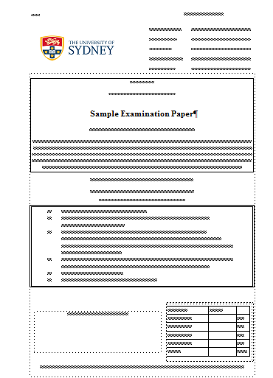
Front page looks just like the real one!

Slide 46

Groups
Make sure you are in the group
Otherwise you get only 50% when your group may receive HD !

Slide 47

Remember next week: Assignment submissions Presentation submissions Group Presentations in tutorial’s Two group’s from tutorial to present in lecture Volunteers ?

Slide 48

Dates for submission
See you next week !

